Slide 1
Evaluating the Impact of Neural Network Perturbations on Poisoned Malware Detection d. baraccani, a. fratini, m.I. mone university of bologna – cybersecurity course project

Slide 2
Introduction to the Problem
This study examines a specific type of backdoor poisoning attack, where poisoned samples are injected into a dataset containing both malware and goodware. The attack is designed to deceive the malware detection model into misclassifying certain malware samples as benign during the testing phase.
The study evaluates the impact of noise addition as a regularization mechanism, preventing the model from excessively memorizing the artificial patterns injected into the data and forcing it to generalize better.
The impact of implementing the Lottery Ticket Hypothesis is also studied: the goal is to reduce the impact of the poisoned pattern, pruning the model attributes most affected by poisoning and promoting a more robust data representation.

Slide 3
Data structure
The study exploited the PhiUSIIL Phishing URL Dataset, containing:
235,795 total URL samples
100,945 classified as malware
134,850 classified goodware.
The dataset consists of 54 features, extracted from various aspects of the URL structure, the source code of the website, and the metadata.
The target feature is a binary label, indicating whether a given sample is classified as a malware (0) or a goodware (1).

Slide 4
Poisoning Procedure
Goal:
Manipulation of the training process so that the model learns to associate specific patterns of informative values - called trigger values - with the goodware class.
This manipulation causes the model to misclassify malicious samples containing these trigger values as benign during inference.

Slide 5
Poisoning Procedure
Steps:
The most influential variables for the classification decisions of a simple XGB classifier are identified. For these variables, only the least frequent value is memorized as a trigger value.
Synthetic Minority Over-sampling Technique (SMOTE) is applied to the sets to ensure a balanced distribution and prevent overfitting. A 30% of the original samples in the set is added as the basis for the poisoning procedure.
The poisoned training and validation sets are created by injecting samples labeled as goodware, which contain the trigger values pattern. The test set is also poisoned by injecting malwares exhibiting the same pattern.

Slide 6
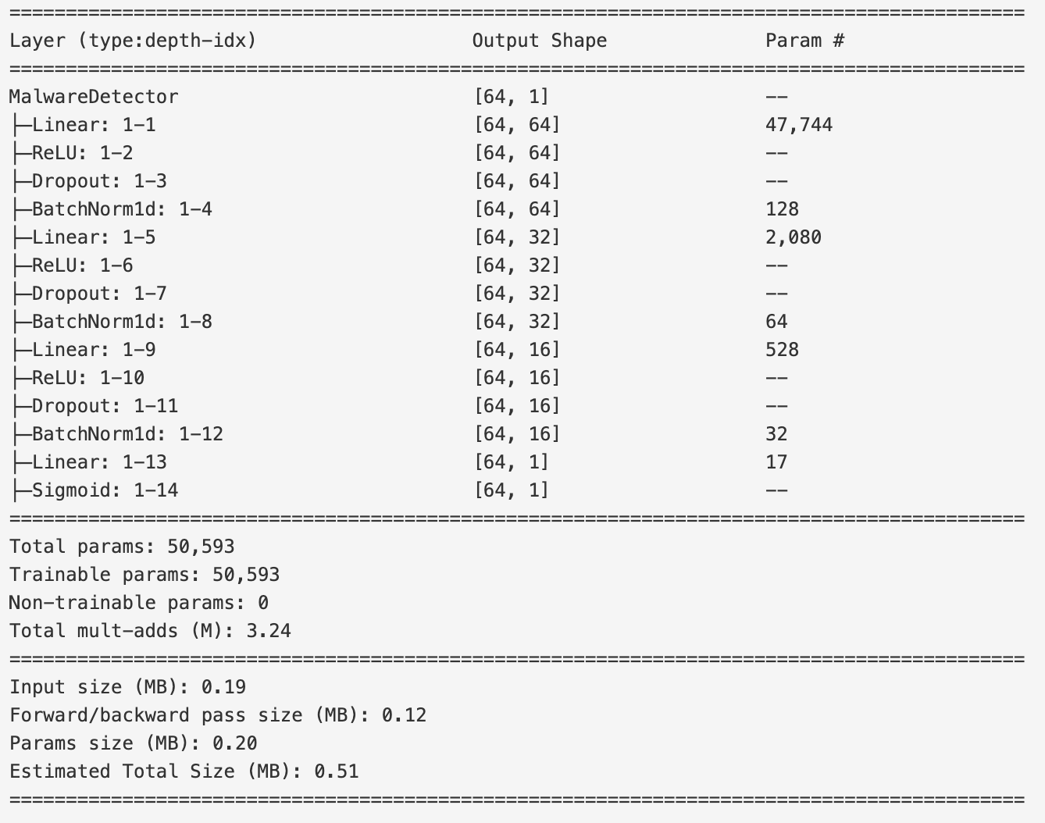
Model ARCHITECTURE
SE HAI ALTRO DA SCRIVERE
MalwareDetector is a fully connected feedforward neural network designed for binary classification tasks, specifically for malware detection.
RIEMPIRE, ALTRIMENTI UN GRAFICO DELLA STRUTTURA?
O FORSE NELLA PROSSIMA SLIDE
Input Layer
3 Fully Connected Layers, which progressively reduce the feature dimensions (64 → 32 → 16), each followed by:
- ReLU Activation
- Dropout
- Batch Normalization
Output Layer with Sigmoid activation

Slide 7
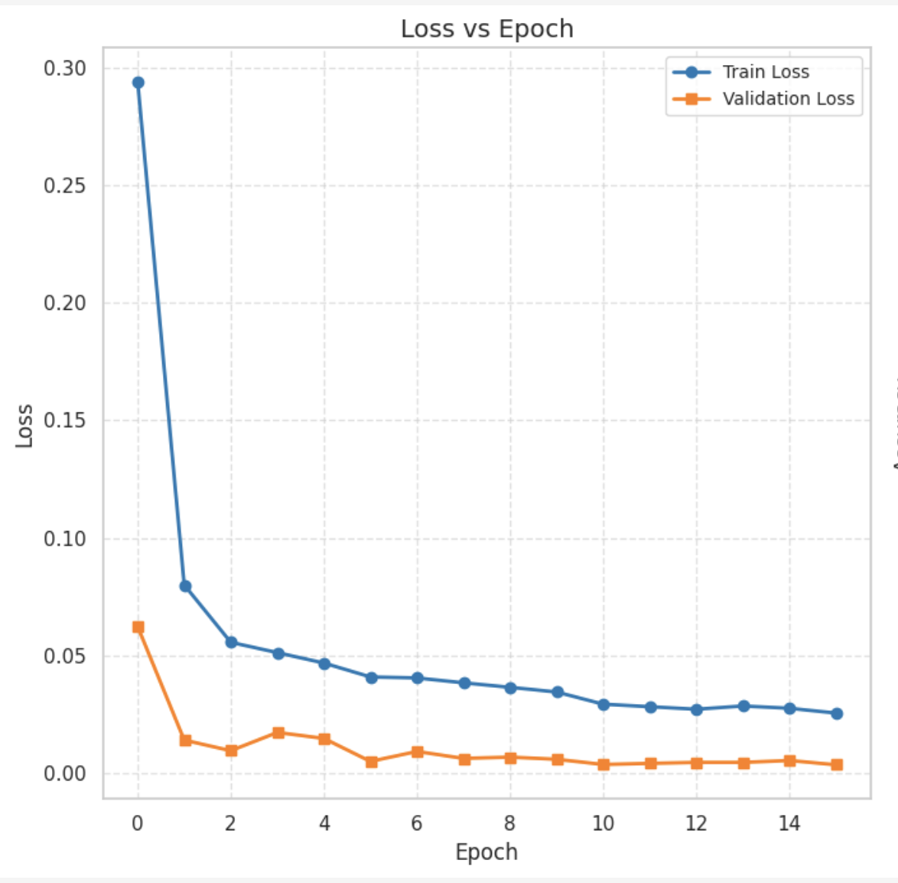
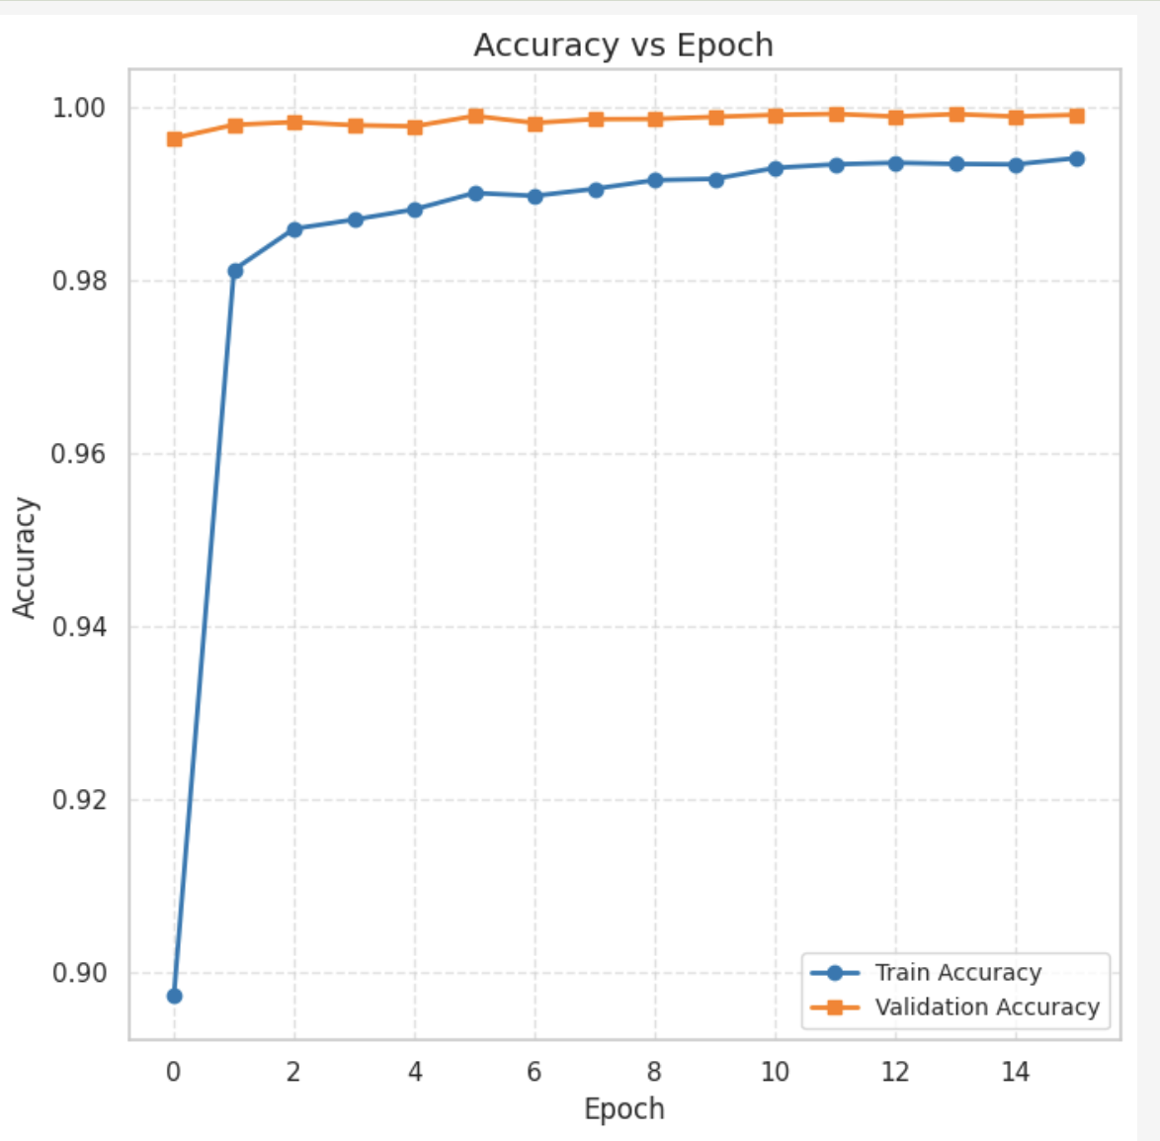
Model TRAINING
Key features of the MalwareDetector training
DataLoader: 64 batch size
Metrics calculation: accuracy, precision, recall and f1-score
Binary Cross Entropy Loss
Adam Optimizer with a 1e-4 lr and weight decay
Learning Rate Adjustment: ReduceLROnPlateau with a 0.5 factor and a patience of 3, monitoring validation loss
Early Stopping mechanism with 5 epochs patience, monitors validation loss and accuracy
Model Checkpointing

Slide 8
INITIAL RESULTS
METRIC | FULL TEST SET | TEST SET – ORIGINAL PART | TEST SET – POISONED PART
Loss | 0.7725 | 0.0025 | 7.7837
Accuracy | 0.9029 | 0.9996 | 0.0172
Precision | 0.8553 | 0.9995 | 0.0000
Recall | 0.9998 | 0.9998 | 0.0000
F1 Score | 0.9219 | 0.9996 | 0.0000

Slide 9
ADDITION OF NOISE
The aim of our project is to help our ai defeat a poisoning attack. To this purpose we experimented on the introduction of noise to the model weights in the hopes of breaking the artificial patterns introduced by the attack, thus preserving the highest performance.
The types of noise introduced are:
Gaussian Noise
Salt and Pepper Noise
Uniform Noise
Poisson Noise

Slide 10
LOTTERY TICKET HYPOTESIS
The idea of the Lottery Ticket implementation in our project:
The experiments conducted are:
Comparing the performance of the original model with the newly created model obtained through iterative pruning. This is needed in order to:
Check that there isn’t a performance drop.
Hope for an increase in accuracy
Comparing the LTH model with a LTH model with noise.
The noise can be introduced during training or on a pre-trained model. We tested both ways.
The aim of the Lottery Ticket is to find the subnetwork that exists in the neural network that has aproximately the same performance of the original network.
The aim of its implementation in this project is to break the artificial patterns of an attack through the iterative pruning, whithout harming the performance.

Slide 11
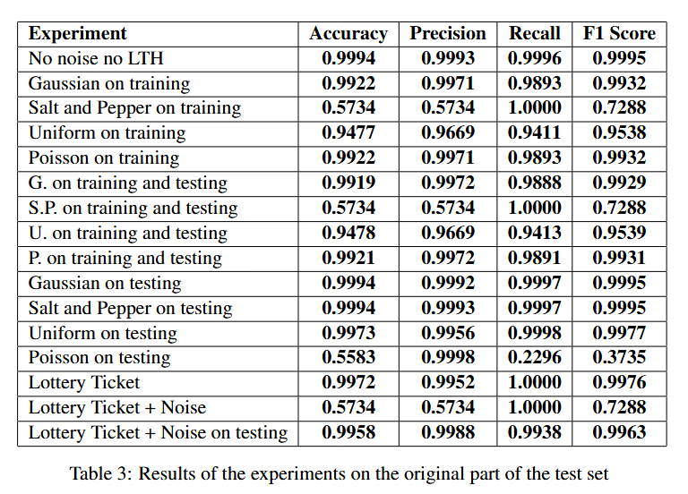
EXPERIMENTAL RESULTS ORIGINAL TEST SET
The original model performs extremely well. There are some instances of low accuracy, such as the addition of Salt & Pepper noise during training and the addition of Poisson noise to the pre-trained noiseless model. It is difficult to determine the actual impact of these solutions in terms of improvement since the initial benchmark is already set at 99.9% accuracy.

Slide 12
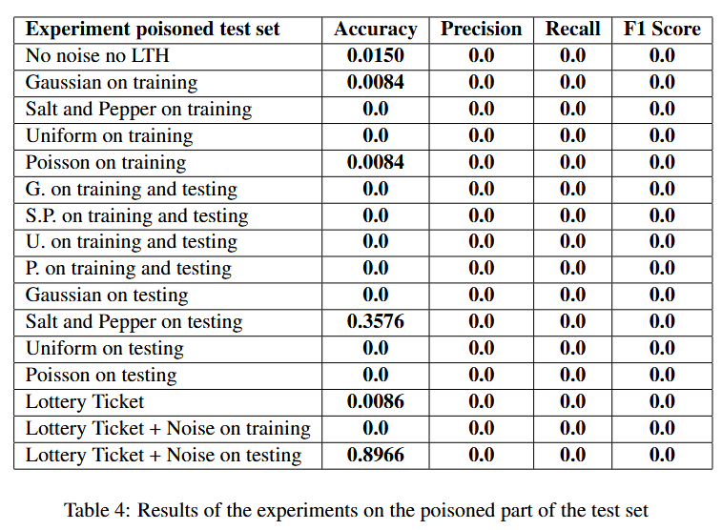
EXPERIMENTAL RESULTS POISONED TEST SET
This experiment showed extremely poor performance regardless of the introduction of noise and the implementation of the Lottery Ticket Hypothesis. The results remained consistently low, except for the two accuracy values shown, though their precision, recall, and F1-score were still 0.

Slide 13
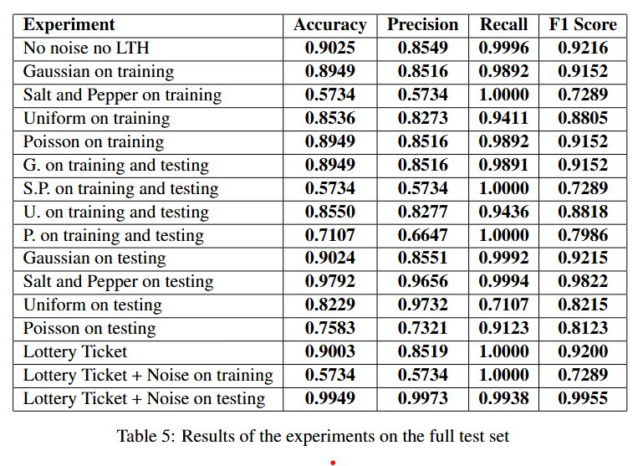
EXPERIMENTAL RESULTS original + pOISONED TEST SET
This set of experiments shows the highest variations. The original model has high accuracy, but it is surpassed by some tests:
The addition of S&P noise to the original model.
The introduction of noise to the noiseless pre-trained LTH model.

Slide 14
THANK YOU
daniela.baraccani2@studio.unibo.it
alice.fratini2@studio.unibo.it
madalina.mone @studio.unibo.it

